Slide 1
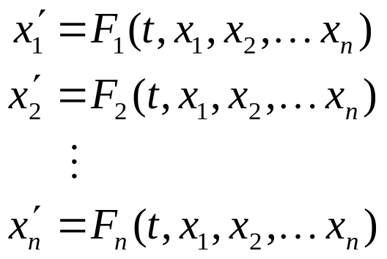
Ch 7.1: Introduction to Systems of First Order Linear Equations
A system of simultaneous first order ordinary differential equations has the general form
where each x_{k} is a function of t. If each F_{k} is a linear function of x₁, x₂, …, x_{n}, then the system of equations is said to be linear, otherwise it is nonlinear.
Systems of higher order differential equations can similarly be defined.

Slide 2

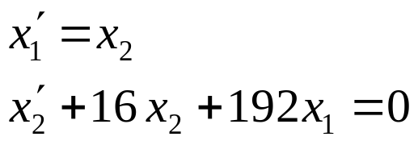
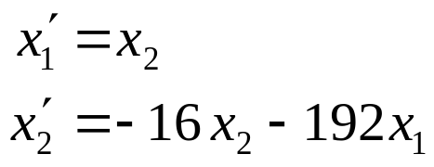
Example 1
The motion of a spring-mass system from Section 3.8 was described by the equation
This second order equation can be converted into a system of first order equations by letting x₁ = u and x₂ = u'. Thus
or

Slide 3


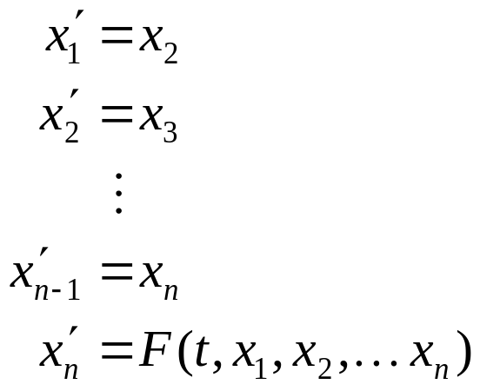
Nth Order ODEs and Linear 1st Order Systems
The method illustrated in previous example can be used to transform an arbitrary nth order equation
into a system of n first order equations, first by defining
Then

Slide 4
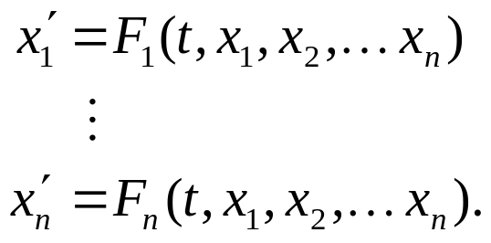


Solutions of First Order Systems
A system of simultaneous first order ordinary differential equations has the general form
It has a solution on I: α < t < β if there exists n functions
that are differentiable on I and satisfy the system of equations at all points t in I.
Initial conditions may also be prescribed to give an IVP:

Slide 5

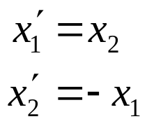
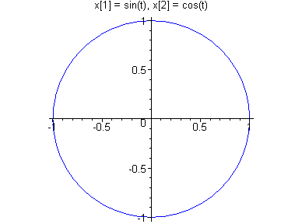

Example 2
The equation
can be written as system of first order equations by letting x₁ = y and x₂ = y'. Thus
A solution to this system is
which is a parametric description
for the unit circle.

Slide 6

Theorem 7.1.1
Suppose F₁,…, F_{n} and ∂F₁/∂x₁,…, ∂F₁/∂x_{n},…, ∂F_{n}/∂ x₁,…, ∂F_{n}/∂x_{n}, are continuous in the region R of t x₁ x₂…x_{n}-space defined by α < t < β, α₁ < x₁ < β₁, …, α_{n} < x_{n} < β_{n}, and let the point
be contained in R. Then in some interval (t₀ - h, t₀ + h) there exists a unique solution
that satisfies the IVP.

Slide 7
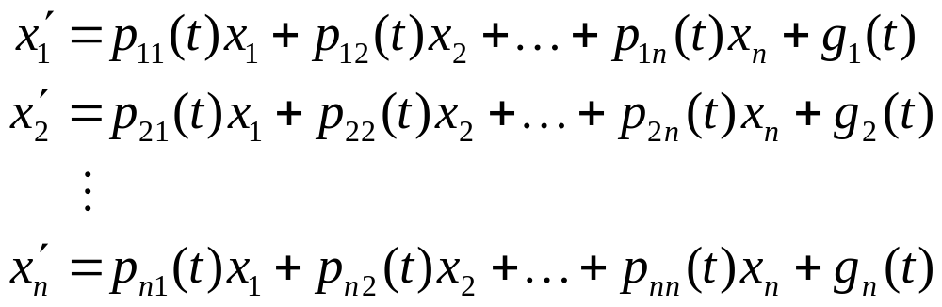
Linear Systems
If each F_{k} is a linear function of x₁, x₂, …, x_{n}, then the system of equations has the general form
If each of the g_{k}(t) is zero on I, then the system is homogeneous, otherwise it is nonhomogeneous.

Slide 8

Theorem 7.1.2
Suppose p₁₁, p₁₂,…, p_{nn}, g₁,…, g_{n} are continuous on an interval I: α < t < β with t₀ in I, and let
prescribe the initial conditions. Then there exists a unique solution
that satisfies the IVP, and exists throughout I.

